Slide 1
Computable News
How do we unlock knowledge from text?

Slide 2

Notes:
Caption: “deep experience in financial and health markets.”?
A large part of big data isn’t found in structured databases -- it’s in text. And to interpret unstructured text, the challenge is to extract and identify entities.
People, places, organisations, products or general concepts -- the named things that your text is about.
http://footage.shutterstock.com/clip-770416-stock-footage-rotating-matrix-cube.html?src=search/ifv0PJwKzTkdo7tqATjPSA:1:24

Slide 3
Name
Notes:
The key problem we solve is called Named Entity Linking: finding names in text and linking them to a knowledge base -- such as Wikipedia.
There are products on the market that identify names, but few of them link names to a knowledge base. This technique is really powerful because it addresses ambiguity, which is pervasive in Natural Language and is what makes this task so difficult.

Slide 4
Identity

Slide 5
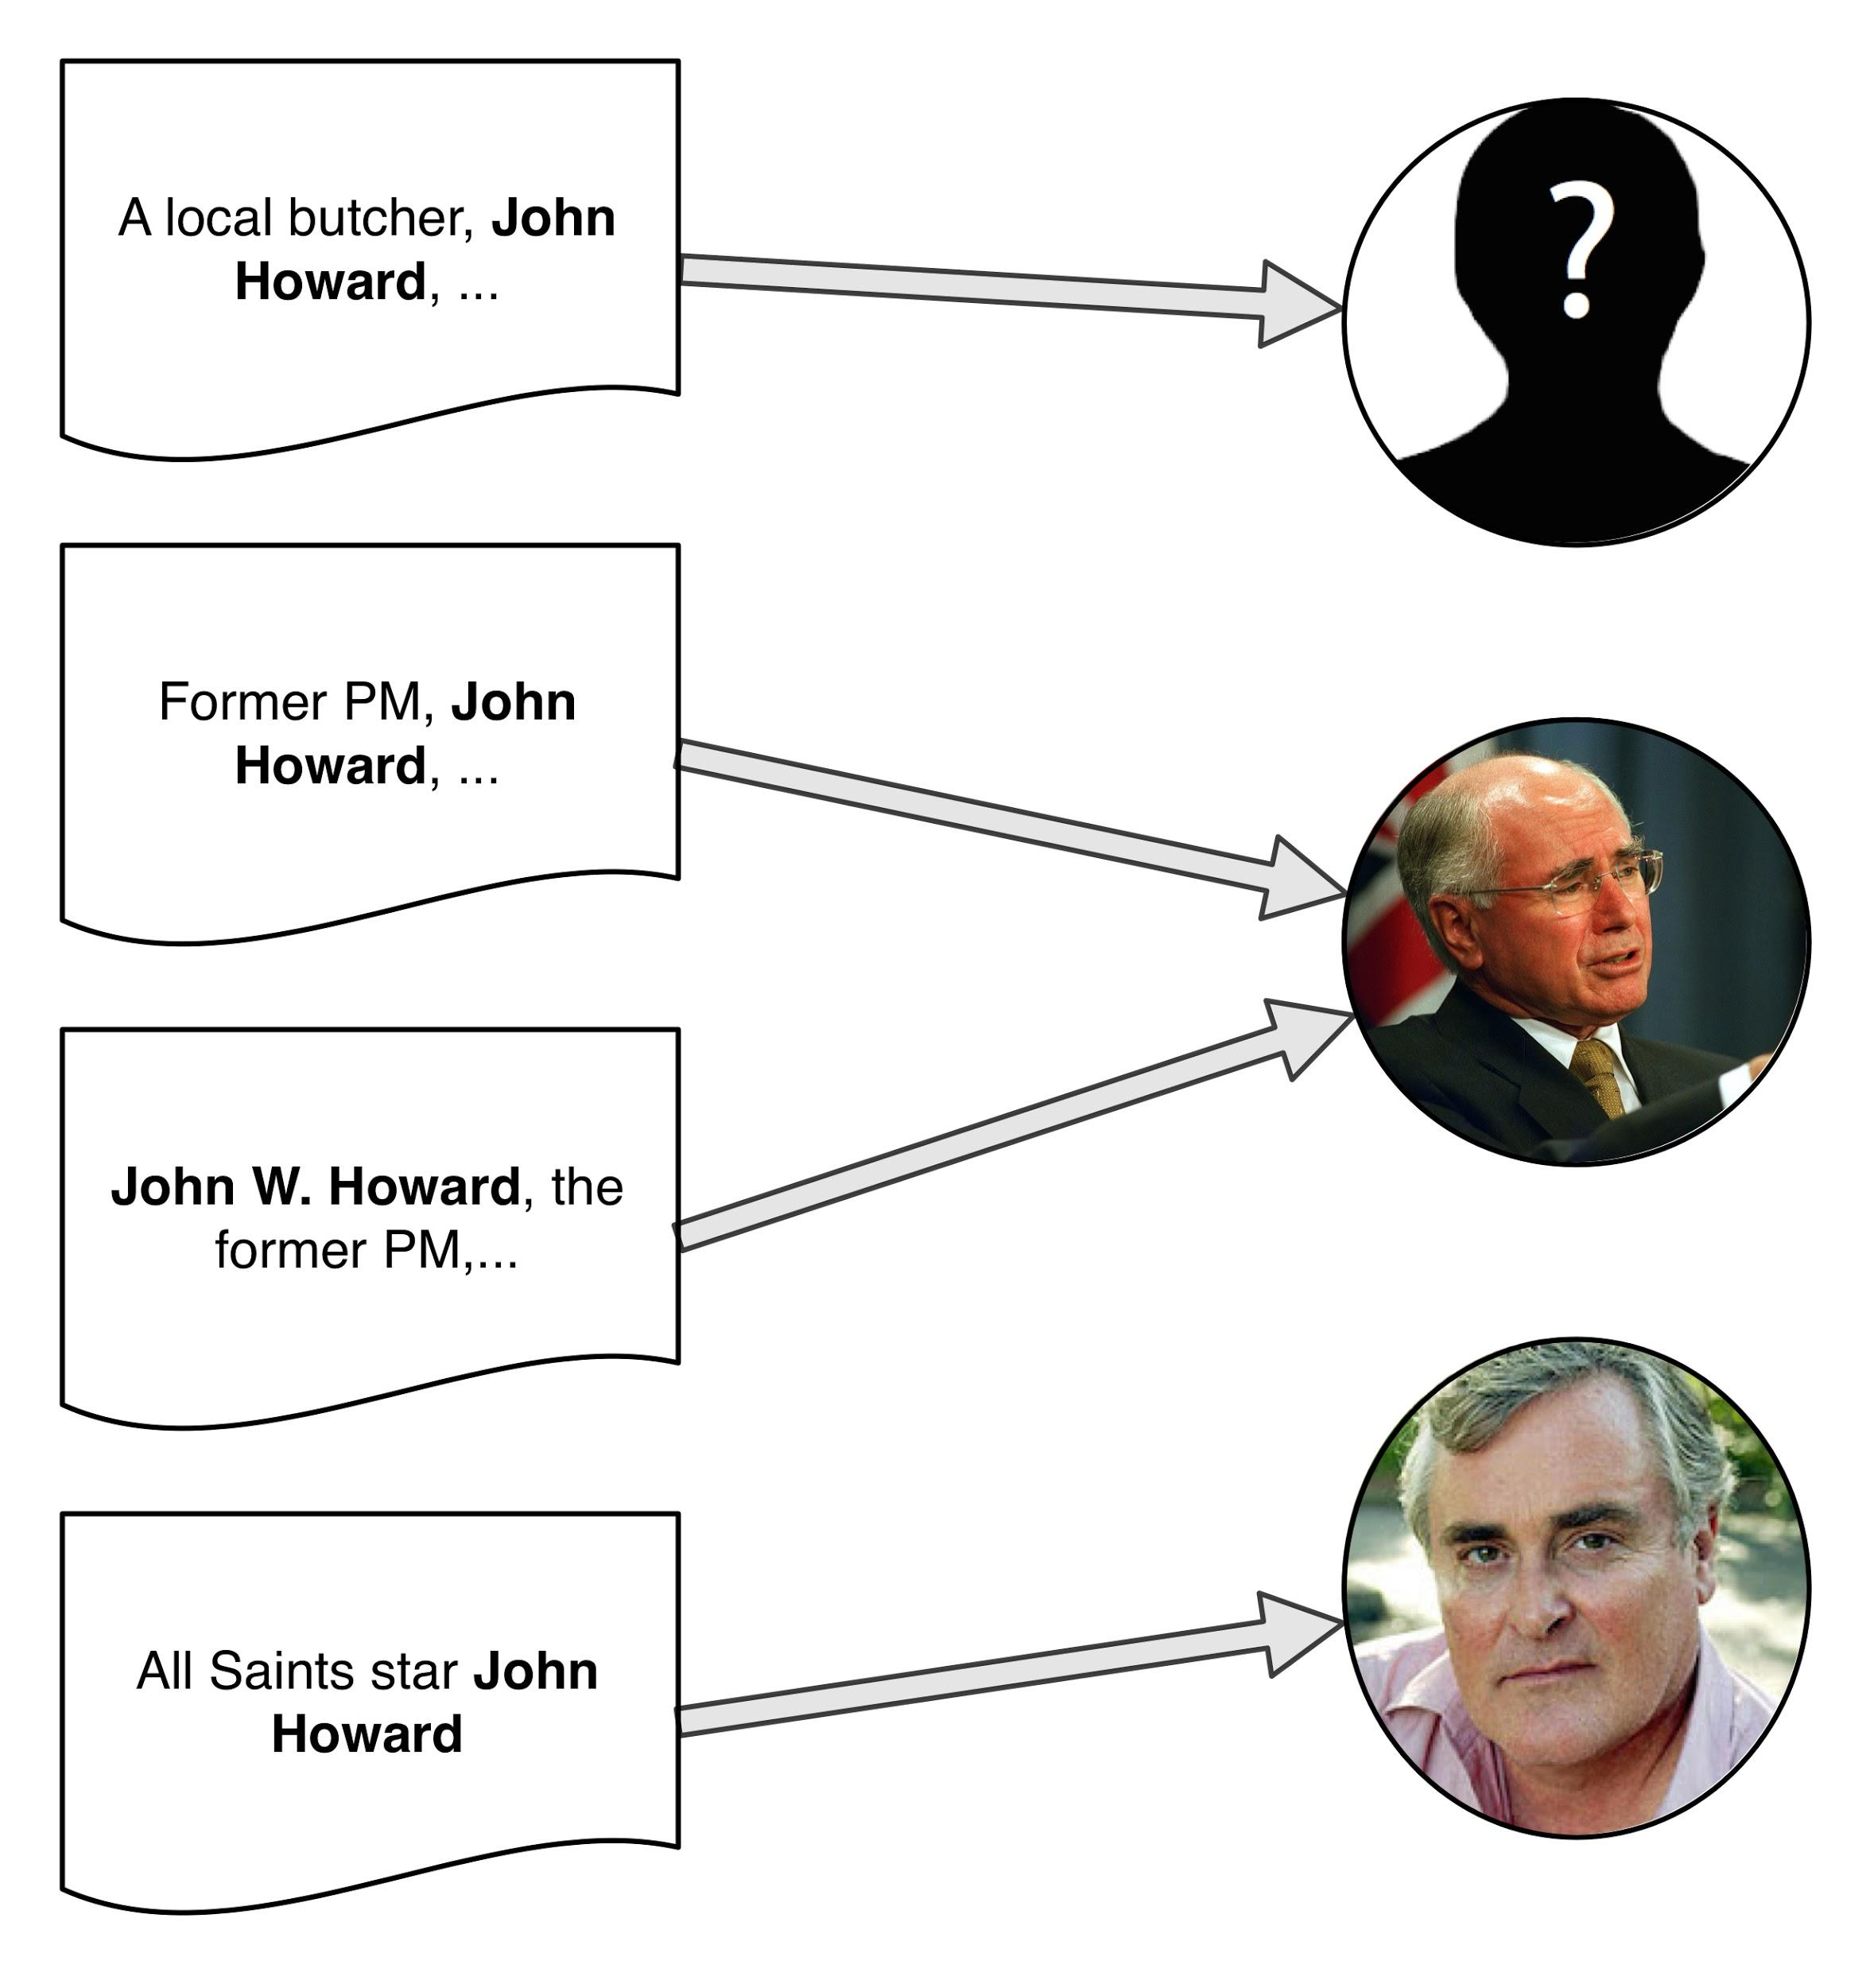
Notes:
Consider the name “John Howard”. If we are looking for John Howard, the former Australian politician, we don’t want to read about the actor, or some other John Howard.
We want to find the name “John Howard” or “John W. Howard” from text and link it to the right Wikipedia page.
To give you a sense of the scale of the problem, Wikipedia lists over 30 different John Howards.

Slide 6
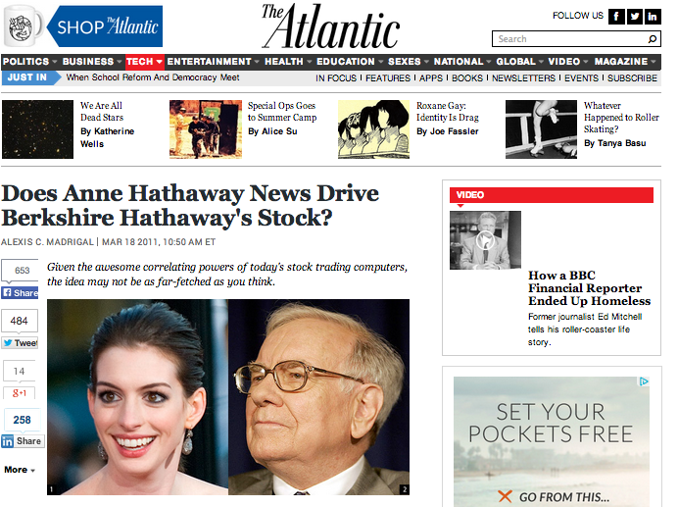
Notes:
This problem isn’t limited to news.
Algorithmic traders create programs that automatically respond to information news to trade in financial markets.
In 2011, The Atlantic reported interesting patterns between Anne Hathaway movie news and Berkshire Hathaway share price movements. This suggests there are programs incorrectly buying stock on the basis of a glowing movie review.
These programs have an identity problem.

Slide 7
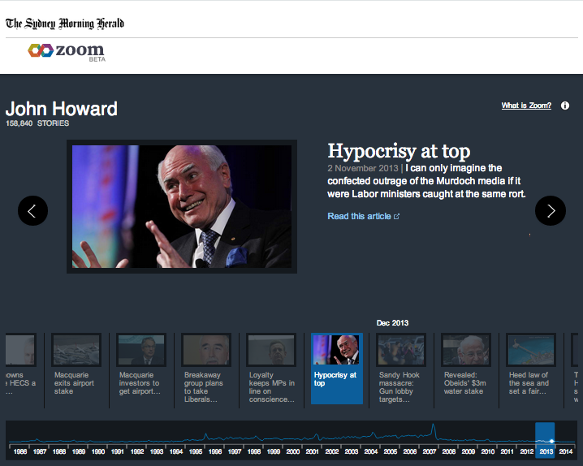
Notes:
“Zoom” is the first showcase product for the Computable News platform.
We developed the platform with Fairfax Media to understand their core IP, their extensive news archive.
We link two decades of Sydney Morning Herald news stories to a knowledge base and turn the user experience on its head, letting the data tell the story through entity pages.
Here’s John Howard the politician’s page, with a timeline of stories that he’s been mentioned in.

Slide 8
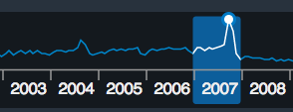
Notes:
This chart shows trends over time, and we see peaks for newsworthy events like elections.

Slide 9
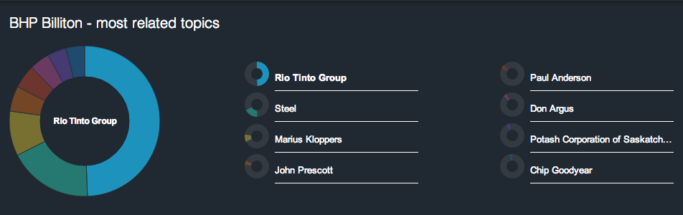
Notes:
Switching entity to BHP Billiton, we can explore related entities.
We designed a custom statistic for Fairfax to identify other entities mentioned with BHP.
You can see competitors (Rio Tinto), general concepts (steel), executives and board members. The Potash Corporation of Saskatchewan may seem out of place at first glance, but in fact, it was a takeover target in 2010.
Zoom lets us drill down into two decades of news and uncover interesting connections.

Slide 10

George Wright, Solutions Lead, Data & Analytics at Fairfax Media
Notes:
The Computable News platform handles the cutting edge Natural Language Processing technologies so we do what we do best - telling stories.
We use the Computable News tools to help curate our own custom Knowledge Base and drive user engagement with our site.

Slide 11

Assuring market quality in finance and health markets
Notes:
Caption: “Explore your text!”
Caption: “Get insight into your data!”
We have expertise in helping build intuitive applications like “Zoom” for your customers. We provide APIs for developers so they don’t need to master state-of-the-art Natural Language Processing technologies to use the platform.
If you’ve got business-critical knowledge stored in text, and don’t want to miss opportunities to exploit it, we can help you.
Caption: “More information at www.cmcrc.com”

